Slide 1


OPERATION ANALYTICS & INVESTIGATION METRIC SPIKE
AIM-Using the dataset provided, calculate
Efficiency , effectiveness & overall performance
Of an organization
-SUMMIT TABHANE

Slide 2

JOB DATA ANALYTICS Using the case-1 dataset , solving out different problems which arise in a company. The data includes id, language, actor_id , time spent & org. Analysis performed in the project:- *Job Review overtime *Throughput Analysis *Language Share Analysis *Duplicate Row Detection

Slide 3
JOB REVIEWED OVERTIME
Calculating jobs reviewed per hour for each day in the month provided(November).
Importing the data from the CSV file in MySQL, by loading the data in MySQL in tabular form by creating table and inserting respective values in the table.
LOGIC:-
Selecting the columns from the table & converting string to date.
Counting the job_id .
Grouping the data by date and hour and arranging in an order by date and hour.

Slide 4
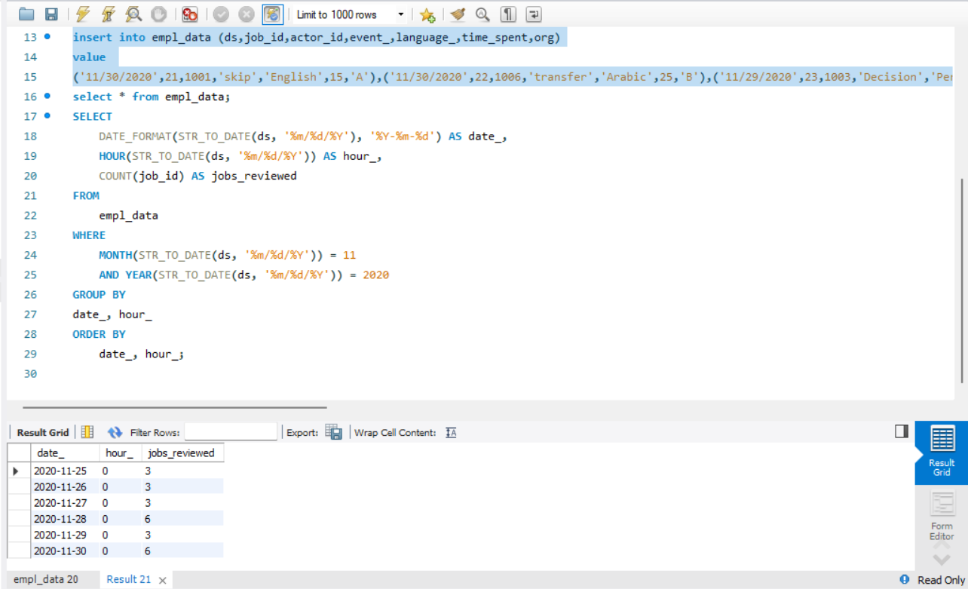
QUERY USED :-

Slide 5
OUTPUT:- The output found out is attached on the table, where dates and number of job reviewed is shown
date | hour | Job_reviewed
2020-11-25 | 0 | 3
2020-11-26 | 0 | 3
2020-11-27 | 0 | 3
2020-11-28 | 0 | 6
2020-11-29 | 0 | 3
2020-11-30 | 0 | 6

Slide 6
THROUGHPUT ANALYSIS
Using the job data of the past 7 days to & averaging the data to know about the trend and daily routine.
Total events on a day is calculated from the table .
The string is converted to date format and labelled as event_date.
The event_date is summed and 7 days average is calculated by dividing the event_date sum by 7.
Event_date | Total_events | Rolling_avg_throughput
2020-11-26 | 19 | 5.4286
2020-11-27 | 19 | 8.1429
2020-11-28 | 38 | 13.5714
2020-11-29 | 19 | 16.2857
2020-11-30 | 39 | 21.8571

Slide 7
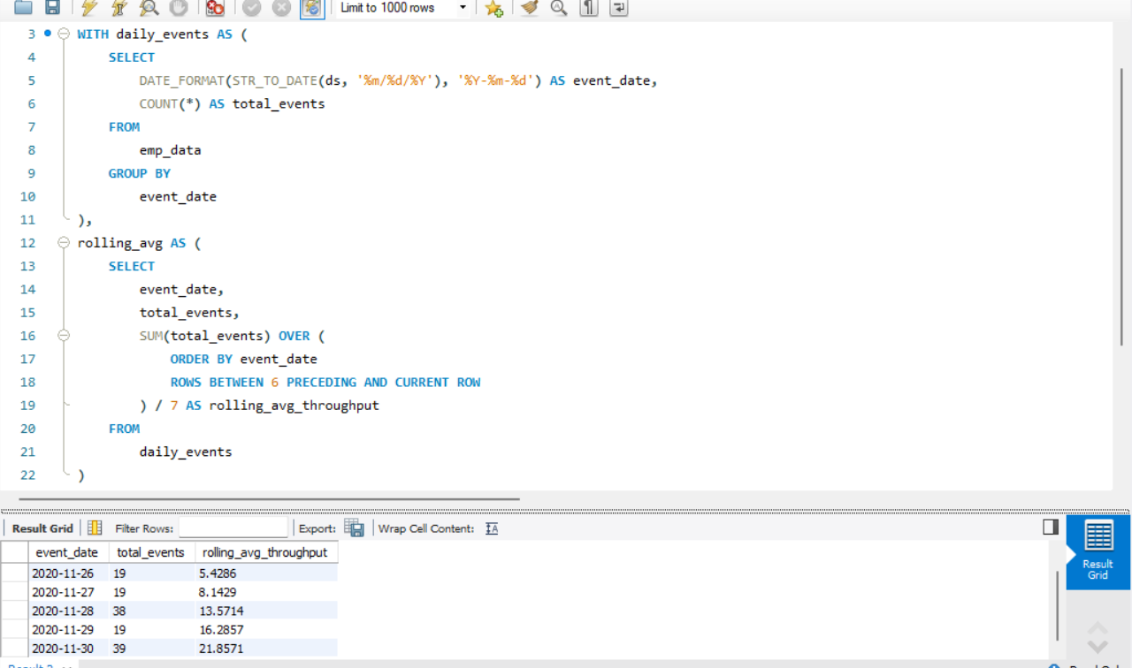

Slide 8
PERSONAL RESPONSE:-
Daily metric & 7 day average both can be used to analyze the metric of an organization.
But as an analyst I would prefer to use daily metrics as it provides more real time and daily based data.
Daily metric can be used to real quick insights of the organization, whereas 7-day rolling average can be used to decide the trend of the market.
Daily metric can be used to identify the sudden spike and to get immediate actions on sudden failure.
That's why I would prefer daily metric over throughput/7-days rolling method.

Slide 9
LANGUAGE SHARE ANALYSIS:-
AIM is to find the percentage share of each language in past 30 days.
To get to know about the percentage of share every job holds in the office.
This query calculates the percentage share of each language used in the last 30 days. It counts the number of activities for each language, calculates the share by dividing by the total activities, and orders the results by language popularity.

Slide 10
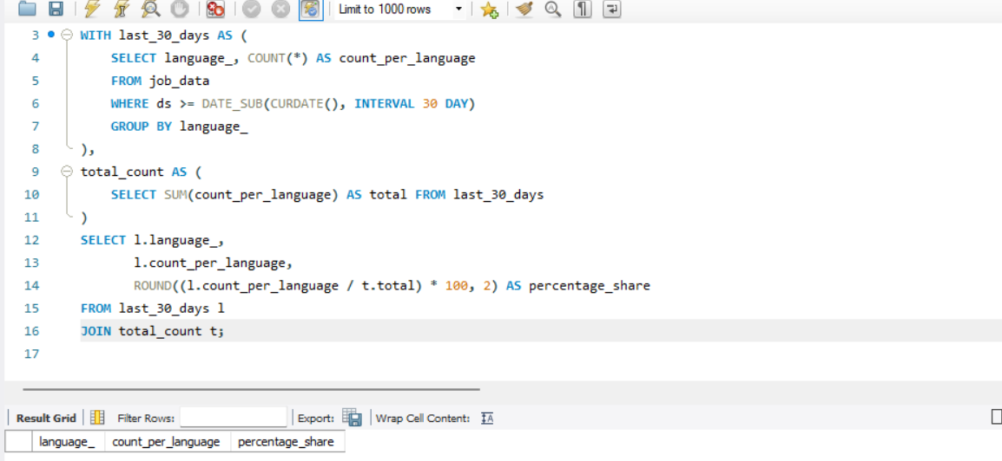

Slide 11

DUPLICATE ROW DETECTION
This query identifies duplicate rows by grouping data based on key . It counts occurrences of each combination and filters to show only those that appear more than once using HAVING COUNT(*) > 1. This helps detect and manage duplicate records.

Slide 12
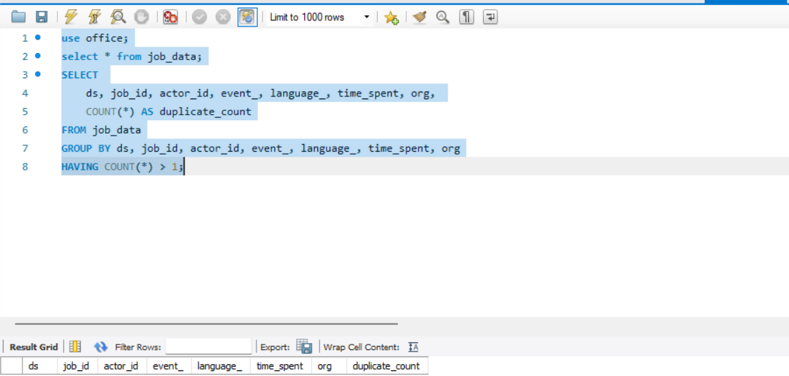

Slide 13
INVESTIGATING METRIC SPIKE Using the data provided finding out the reason, for the sudden metric spike in any organization to identify trends, anomalies and segment breakdown. The data provided was of email_events and users and events. The major task to perform in the project was:- *Weekly User Engagement *User Growth Analysis *Weekly Retention Analysis *Weekly Engagement Per Device *Email Engagement Analysis

Slide 14
WEEKLY USER ENGAGEMENT
In order to find out the activeness of the user we used the users csv file.
Firstly importing the csv data through table import wizard in MySQL.
Analyzing the rows and columns of the data provided.
The SQL query groups interactions by week, ensuring insights into user retention and behavioral trends.
Extracting the week number and counting distinct users . It groups data weekly and orders results to track user engagement trends over time.
Through nested query in sql calculating the user_id and state='active' to get the total count of the users.
Active_users
9381

Slide 15
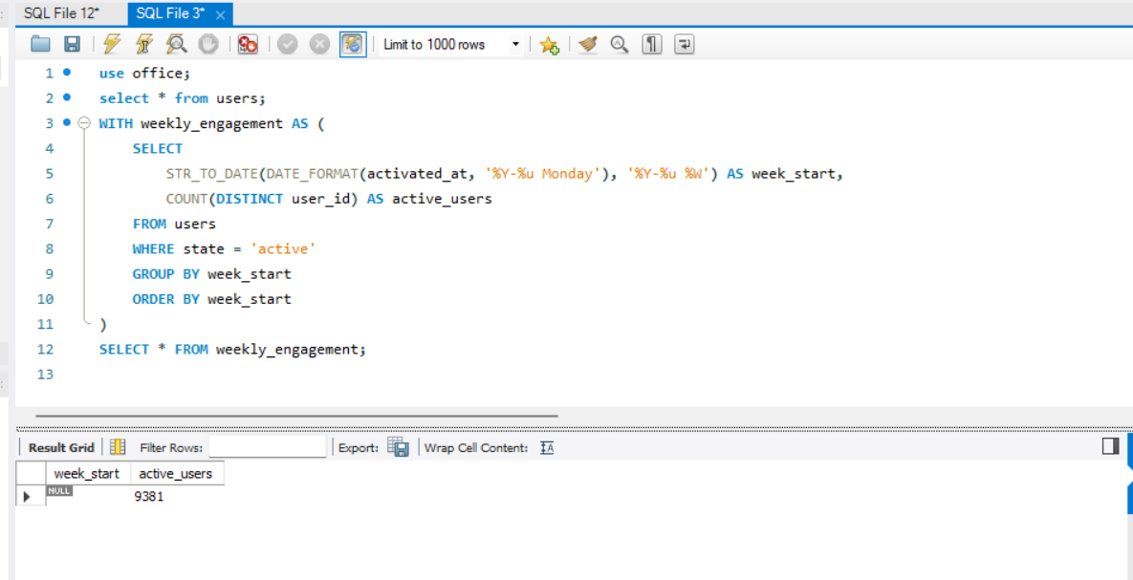

Slide 16

USER GROWTH ANALYSIS
Analyzing the growth of users overtime for a product.
This project analyzes user growth trends over time by tracking new user sign-ups and cumulative user count. The SQL query calculates the number of new users per time period and their cumulative growth.
From the users csv file running the nested query by counting the user_id and adding the user_id count over date aas activated_at to get cumulative user.
date | New_user | Cumulative_user
null | 9381 | 9381

Slide 17
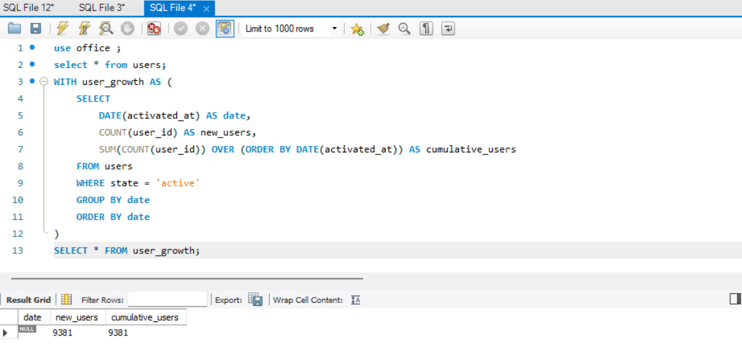

Slide 18

WEEKLY RETENTION ANALYSIS:-
This project analyzes user retention on a weekly basis by tracking user cohorts based on their sign-up week and measuring how many users remain active in subsequent weeks.
The SQL query assigns users to cohorts based on their signup date, then calculates weekly retention rates by comparing cohort users who return each week. This helps businesses assess user stickiness, engagement trends, and product effectiveness over time.
Grouping users into cohorts based on their signup .
Counting active users who returned in subsequent weeks using event data .
Calculating retention rates as retained_users divided by initial cohort size, enabling cohort-based retention analysis.
Retained_user | Retention_rate
4107 | 1.00

Slide 19
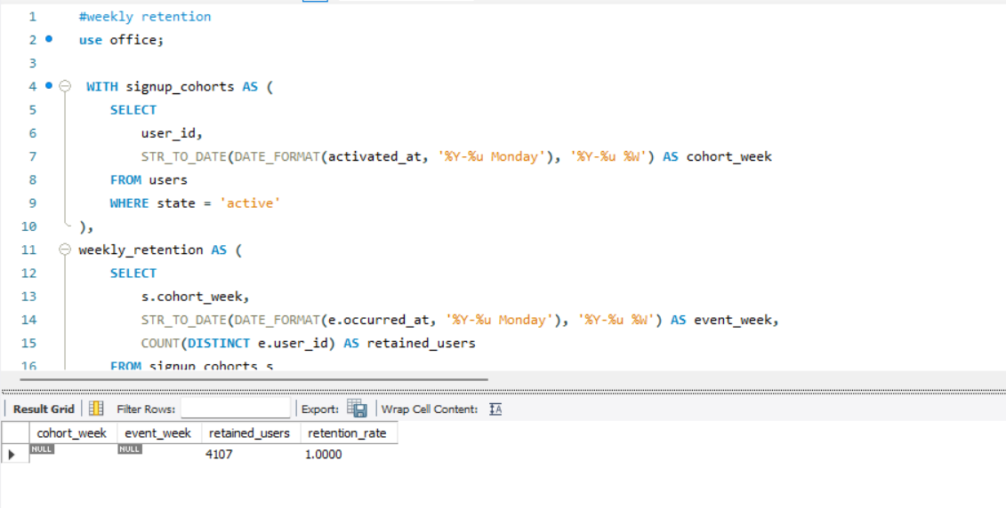

Slide 20

WEEKLY ENGAGEMENT PER DEVICE
This project analyzes user engagement on a weekly basis across different devices.
The SQL query groups users by device type and week to calculate the number of active users per weekly.
This helps in understanding device-specific engagement trends, optimizing platform performance, and tailoring user experiences for specific devices.
Using the email_events csv file .
The query calculates the number of distinct users performing each action on specific dates. It groups the data by date and action, counts users per group, and returns the results ordered by date and action.

Slide 21
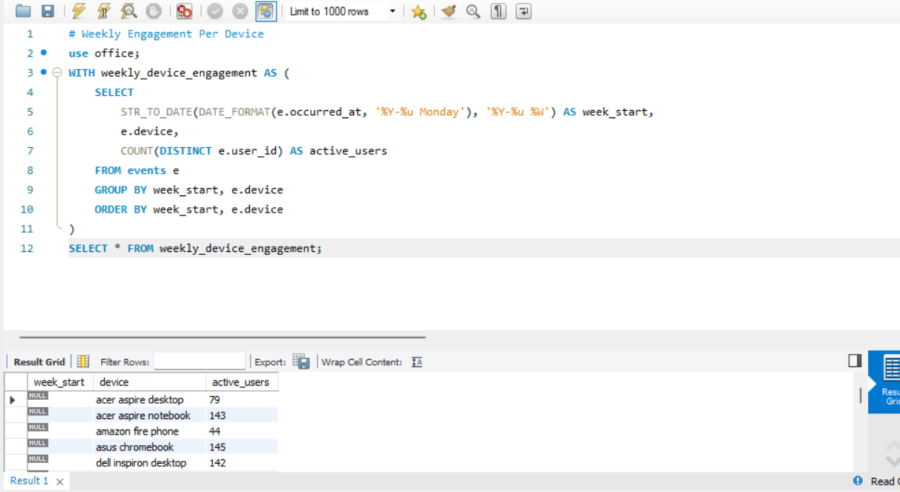

Slide 22

EMAIL ENGAGEMENT ANALYSIS:-
The goal of Email Engagement Analysis is to measure and understand how recipients are interacting with the emails sent.
Email_events csv file is used for analysis.
By analyzing email engagement metrics, we can evaluate the effectiveness of email marketing campaigns, improve future campaigns, and optimize user experience.
The query calculates email engagement metrics by counting actions for each email. It uses conditional aggregation to count specific actions, calculates averages per user, groups by email, and filters data for a recent time period. Results are ordered by engagement.
Action_ | Action_count
Email_clickthrough | 1427
Email_open | 3935
Sent_weekly_digest | 13186

Slide 23
